Slide 1
Similarity Test
By Matt Macrides

Slide 2
Introduction
I have created a Python program with concepts that I am learning in my class
This program will compare all our answers and find which people are most similar to one another
There will be a series of 16 personality questions to answer
Be honest, no one will see how you answered!!!
Text me your results like this: [a1, a2, a3, … , a16] where a_{i} = {1-10}

Slide 3
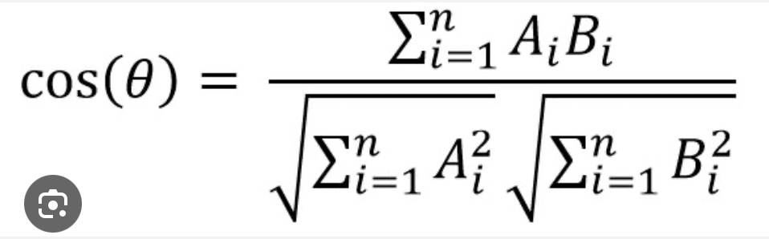
How to measure similarity?
Cosine Similarity
Cosine similarity is a way to figure out how much two things are alike or different in a vector space
The list you will text me is a 16-dimensional space

Slide 4
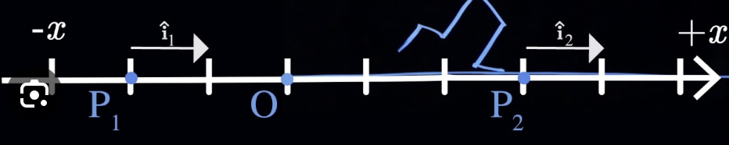
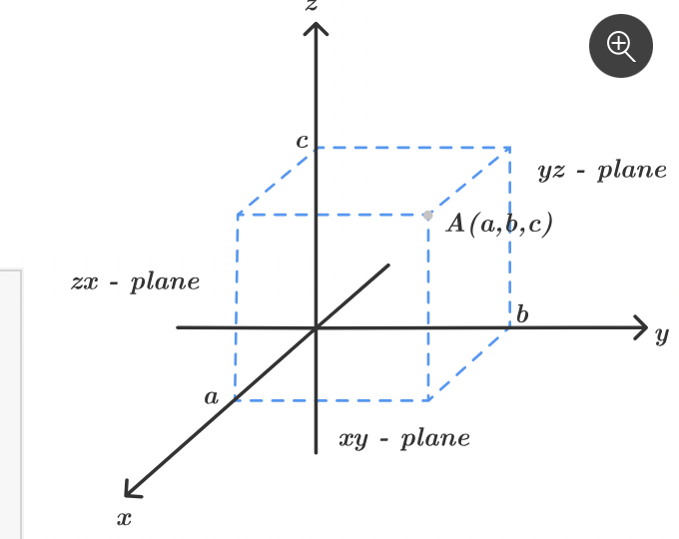
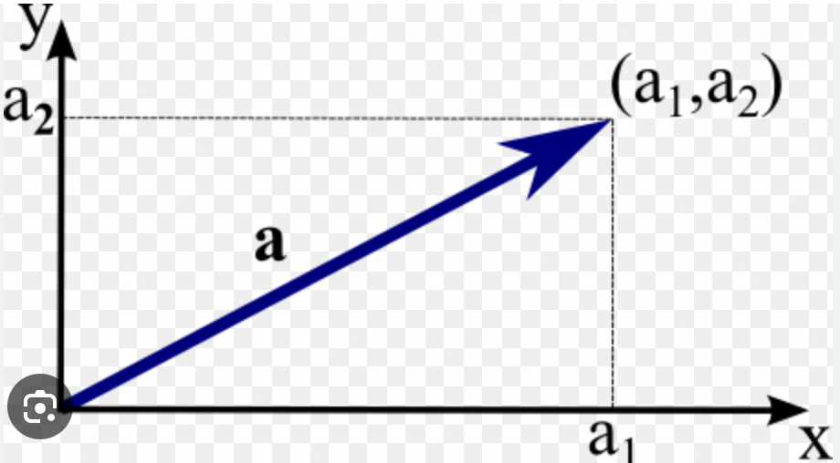
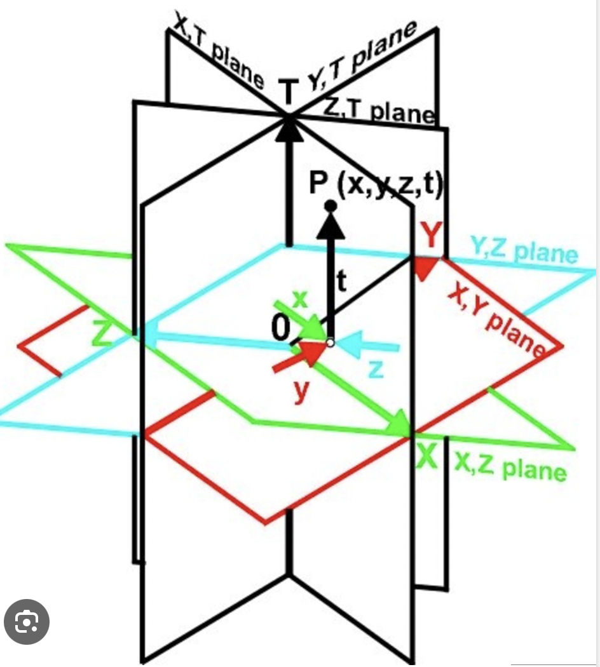

Slide 5
Question 1
Introvert
Extrovert
1
10

Slide 6
Question 2
Loves Small Talk
Hates Small Talk
1
10

Slide 7
Question 3
Risk Averse
Risk Taking
1
10

Slide 8
Question 4
Impatient
Patient
1
10

Slide 9
Question 5
Analytical
Creative
1
10

Slide 10
Question 6
Thinking
Feeling
1
10

Slide 11
Question 7
“I hate Change”
“I love change”
1
10

Slide 12
Question 8
Insecure
Confident
1
10

Slide 13
Question 9
Unreliable
Reliable
1
10

Slide 14
Question 10
Half-Empty
Half-Full
1
10

Slide 15
Question 11
Serious
Hilarious/Comedian
1
10

Slide 16
Question 12
Content
Ambitious
1
10

Slide 17
Question 13
Cooperative
Competitive
1
10

Slide 18
Question 14
Night Owl
Early Bird
1
10

Slide 19
Question 15
Realist
Idealist
1
10

Slide 20
Question 16
Stressed
Relaxed
1
10

Slide 21
Poll
Who will be the most similar pair?
A
Who will share the most similarities with everyone?
A
Who will share the least similarities with everyone?
A

Slide 22
Conclusion
Thank you for participating in the survey
This was a simple instantiation, but similarity measures are used in web retrival (Google Search) and Spotify and Netflix recommendations
I hope you learn how linear algebra, computer science, and artificial intelligence are embedded in our life without us even realizing it
Bye

